Slide 1
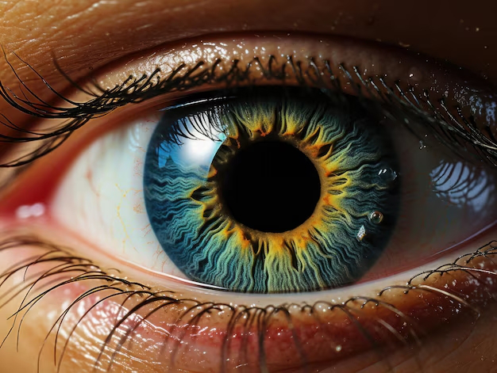
IrisDetect Revolutionizing security and beyond

Slide 2
OUR TEAM
SHUBHAM SINGH:
Mass Intel gathering and extensive resource location
ANIKET CHAKRABORTY:
Extensive resource Location and Intel gathering and Our Website Designer
HITENDRA KUMAR:
Intel Gathering and Resource Location
LUV ASTIK:
Market and data analyst, designing expert, and Financial expertise
ALOKESH BHATTACHARYA:
Extensive resource location and SWOT analysis
ANSHU KUMARI SHAW:
Mass Intel Gathering, Market Analysis, and chief advisor

Slide 3
Semester Work Recap
We devised our semester work based on the requirements during building the project.
Idea: Our idea is an extension to our 5th semester project entitled EYE-D. This time, we have worked on our drawbacks and tried our best to improve the product.
Resources: Articles regarding our resources were gathered from Google websites like wikipedia.org, thewire.in, etc. Majority of our time was focused and used on gathering materials for the presentation. Some graphs were taken from websites while others were prepared by the group.
Presentation: All the materials were gathered, classified into sections for slides and added after careful and necessary modifications.
Speech Preparation: The last part of the semester work was preparing a speech for the presentation. Speeches were distributed accordingly.

Slide 4
ABOUT US………
We are proud to present Iris Detect, the cutting-edge iris detection device designed to enhance security and unlock a world of possibilities across various domains. With its state of-the-art technology and advanced features, Iris Detect sets a new standard in biometric identification systems.
In a biometric system, a person is identified automatically by processing the unique features that are posed by the individual. Iris Recognition is regarded as the most reliable and accurate biometric identification system available. In Iris Recognition a person is identified by the iris which is the part of eye using pattern matching or image processing using concepts of neural networks. The aim is to identify a person in real time, with high efficiency and accuracy by analyzing the random patters visible within the iris if an eye from some distance, by implementing modified Canny edge detector algorithm. The major applications of this technology so far have been: substituting for passports (automated international border crossing); aviation security and controlling access to restricted areas at airports; database access and computer login.
The iris is an overt body that is available for remote assessment with the aid of a machine vision system to do automated iris recognition. A. Iris recognition technology combines computer vision, pattern recognition, statistical inference, and optics. B. The spatial patterns that are apparent in the human iris are highly distinctive to an individual.
Clinical observation
Developmental biology: However, IrisDetect's potential extends far beyond security. In healthcare, our device enables quick and accurate patient identification, streamlining the registration process and ensuring proper care and medication administration. In education, IrisDetect facilitates efficient attendance tracking, reducing paperwork and enhancing overall school security. • With its intuitive user interface and seamless integration capabilities, IrisDetect is adaptable to a wide range of industries. Whether it is retail, transportation, or hospitality, our device offers a convenient and secure means of personal identification and transaction authorization.

Slide 5
Customers & SCALABILITY
Immigration Control In response to the increasing threats of terrorism around the world, NEC contributes to a safe and secure society by enhancing the stringency of immigration control. Our iris recognition solution offers improved security and smooth personal identification amidst the increasing movement of people between countries. The iris is photographed, and the image is matched with the government’s immigration control database during exit or entry procedures at the passport control booth, enabling rapid and stringent personal authentication. Our solution provides improved security through stringent recognition, as well as improved convenience through smooth authentication procedures.
National ID NEC promotes equal access to administrative services by providing legal identification for all citizens. By enhancing the security of national ID systems, our solution contributes to realising more advanced national identification services. Iris recognition is used as one of the methods for acquiring biometric data needed for issuing unique IDs. Accurate and fast authentication is possible even without an ID card. Combined use with mutually complementary biometric data, such as fingerprint and face, enables rigid personal authentication and a robust approach against impersonation. In addition to National ID, the solution is suitable for passports, driver’s licenses, and voter ID systems.
Crime Investigation A multimodal biometrics database for managing multiple biometric authentication data is created by taking images of the face, fingerprint, and palm print, as well as the iris. Combining with fingerprint and other biometric authentication systems enables more accurate identification of an individual. Combined use of biometric data allows recognition even when the fingerprint, for example, could not be used for identification due to injury.

Slide 6
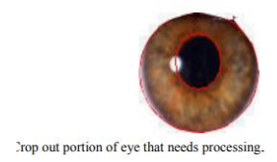
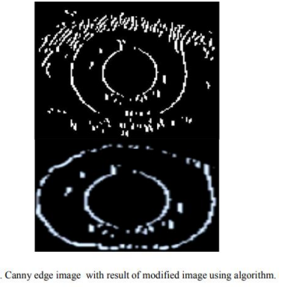
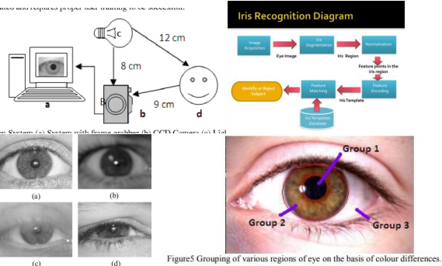
Technology and function
Methodology The system is to be composed of a number of sub-systems, which correspond to each stage of iris recognition.
These stages are:
• Image acquisition-capturing eye image
• Segmentation – locating the iris region in an eye image
• Normalization – creating a dimensionally consistent representation of the iris region
• Feature encoding – creating a template containing only the most discriminating features of the iris.
The input to the system will be an eye image, and the output will be an iris template, which will provide a mathematical representation of the iris region

Slide 7
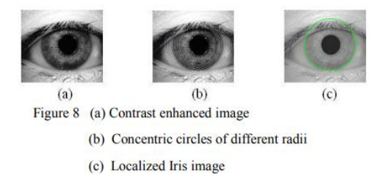
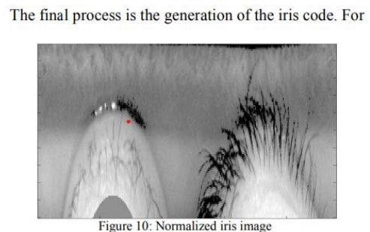
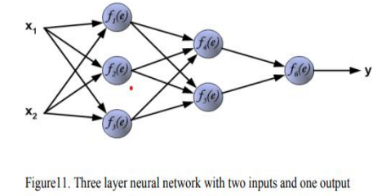
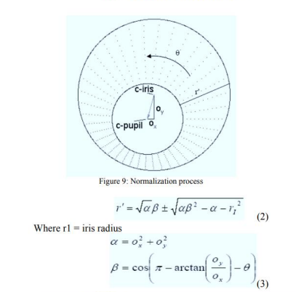
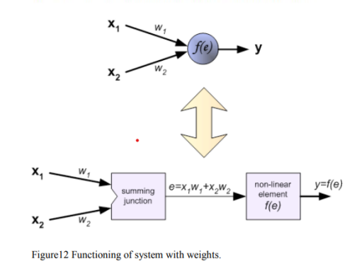
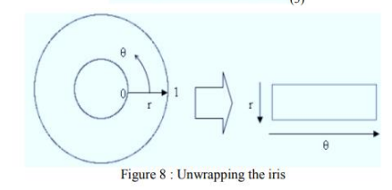
Technology and function (contd.)

Slide 8


MARKET COMPETITION:
In an extensive market analysis, we have thoroughly researched existing solutions and identified key competitors in the iris detection industry. While there are a few similar ideas available, IrisDetect differentiates itself through its innovative features and superior performance.
One notable competitor in the market is EyeSecure, which offers iris recognition technology primarily focused on security applications. However, IrisDetect surpasses EyeSecure and others in several aspects.
Our USP:
IrisDetect incorporates advanced machine learning algorithms that continuously enhance the accuracy and reliability of iris recognition, minimizing false positives and delivering exceptional identification precision.
IrisDetect sets itself apart with its versatility, our device caters to a wide range of industries. From healthcare to education, retail to transportation, IrisDetect seamlessly adapts to various domains, offering a comprehensive solution for personal identification and access control needs.
Their USP:
Other companies store the iris samples of their clients and while scanning they just match through if it matches give access to their clints
Focus solely on security applications .

Slide 9
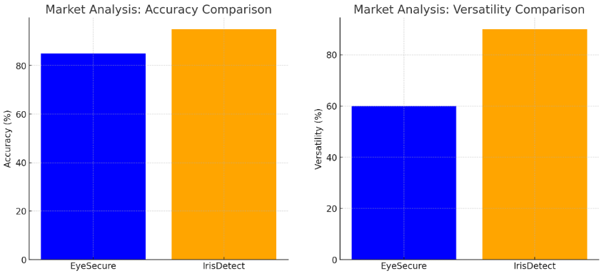
Business and market analysis
Market Analysis:
Conducted extensive research on existing solutions.
Identified key competitors in the iris detection industry.
Notable competitor: Eye Secure, primarily focused on security applications.
Unique Selling Proposition (USP) of IrisDetect:
Advanced Machine Learning: Continuously enhances accuracy and reliability of iris recognition, minimizing false positives.
Versatility: Adaptable to various industries including healthcare, education, retail, and transportation.
Competitors' USP:
Competitors store iris samples and match them during scans.
Focus primarily on security applications.

Slide 10
S-W-O-T ANALYSIS
CATEGORY | IRISDETECT | COMPETITORS
STRENGTHS | - Unique Identification: Highly reliable and accurate due to unique iris patterns. | - Established Market Presence
 | - Advanced Machine Learning: Continuously enhances accuracy and reliability. | - Focused on Security Applications
WEAKNESSES | - Specialized Equipment: Requires specialized hardware, increasing costs. | - Limited Versatility
 | - Market Adoption: Not yet a popular replacement for face lock and fingerprint lock systems. | - Potential Security Vulnerabilities
OPPORTUNITIES | - Diverse Applications: Broad application across healthcare, education, retail, and transportation. | - Growing Security Needs
 | - Scalability: Suitable for businesses of all sizes, enhancing operational efficiency. | - Expansion into New Markets
THREATS | - Emerging Technologies: New biometric technologies may be more cost-effective. | - Technological Advancements in Biometrics
 | - Market Competition: Competitors may offer lower-priced alternatives. | - Increased Regulatory Requirements

Slide 11
pricing
All of our previous presentations had products to be presented for pricing. However, this semester, we’ve diverged from the usual procedures and presented an idea, which does not have effective price. So, we’ll be inspecting some of the products from the internet to give a brief idea about the pricing system followed in this field. When considering pricing strategies, we must strike a delicate balance between accessibility and accountability.
On one hand, making the technology affordable ensures wider adoption and accessibility for various organizations and agencies.
On the other hand, pricing it too low may lead to misuse and exploitation by entities and less-than-honorable intentions.
Irisheld iriTech MK2120U | ₹7,499
MANTRA Single Iris Scanner for Ayushman Bharat Scheme MIS100 V2 Scanner (Black) | ₹9,000
CMI Tech BMT-20 Binoculars Dual Iris Recognition System | ₹28,000
MISTAB 74G Biometric Iris Recognition Tablet | ₹16,499
Here, we can see that the normal purchasable iris detectors cost less than ₹9,000, whereas the binoculars dual iris recognition system costs more than ₹22,000. Even an iris detection tablet is worth around ~ ₹15,000 – quite as much as the modern-day smartphones.
Credits: https://www.cgdev.org/blog/iris-recognition-better-fingerprints-and-falling-price#:~:text=It%20retails%20for%20around%20%24200,%243%E2%80%94%245%20in%20mass%20production.
https://www.flipkart.com/mantra-single-iris-scanner-ayushman-bharat-scheme-mis100-v2/p/itmf9k6h99qxyu8x
https://www.moglix.com/cmi-tech-bmt-20-binoculars-dual-iris-recognition-system-for-biometric-enrollment/mp/msnz5267en7m9x
https://www.ushainfosolution.com/eye-scanner.html

Slide 12
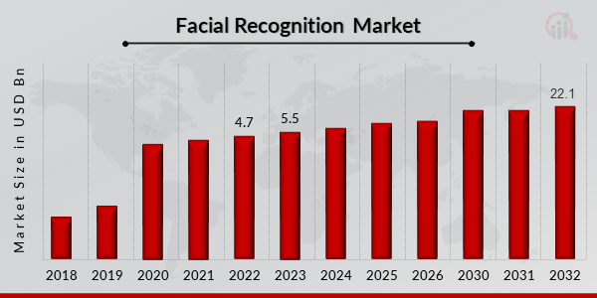
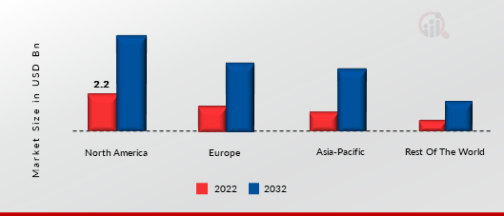
BUSINESS AND FINANCIAL FORECAST
Iris Recognition Market Size was valued at USD 4.7Billion in 2023. The Iris Recognition Market industry is projected to grow from USD 5.5Billion in 2023 to USD 22.1 Billion by 2032, exhibiting a compound annual growth rate (CAGR) of 18.80% during the forecast period (2023- 2032). Increased government investment in Iris recognition technologies and rising demand for advanced video surveillance systems are the key market drivers enhancing the market growth.
August 2023, IIT Madras will launch two initiatives as part of its suicide prevention initiative in the upcoming academic year beginning in August: a face recognition attendance management system for identifying students absent for long periods of time & an app that will allow parents to regularly interact with their children. The automatic attendance system will use face-recognition technology, and it was noted that the institute's data science programs will aid in analysing this data.
Key companies in the Iris Recognition Market include –
Cognitec System GmbH (GERMANY)
Google LLC (US)
3M Company (US)
Aware Inc. (INDIA)
Dell Inc. (INDIA)

Slide 13
THANK YOU
ON BEHALF OF
HITENDRA KUMAR
LUV ASTIK
ANSHU KUMARI SHAW
ANIKET CHAKRABORTY
SHUBHAM SINGH
ALOKESH BHATTACHARYA

